Slide 1

Welcome to Software Development

Slide 2
About me
Fiona Knight - f.l.knight@staffs.ac.uk
Course Leader - Undergraduate Software Development
Lecturer on
Software and web modules
Interaction Design and UX

Slide 3
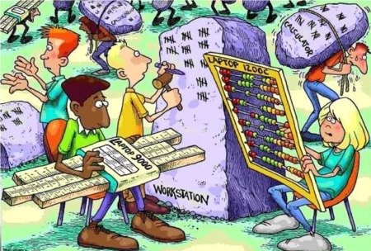
Where would we be..
..Without computers?
Computers need software

Slide 4
What runs the world…
How many of you have used a mobile phone today?
How many of you game on your computer (or tablet or phone)
How many of you use social media or YouTube
How many of you watch Netflix / Amazon / Disney+

Slide 5

Why is that relevant?
All these need software
Add to that cars, home systems, signage on the roads, electronic billboards

Slide 6
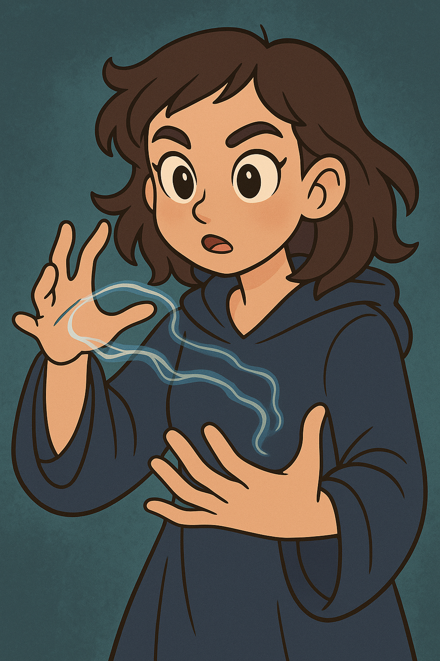
Software is…
..invisible magic
Without it.. imagine what life would be like?
You can learn it and use the power to do all sorts of things

Slide 7

Languages
3 languages to learn how to program

Slide 8
Examples
Fortnite – C++
TikTok filters – Python / AI
Self driving cars – AI + Python
Music Apps – JavaScript
Netflix recommendations – Machine Learning

Slide 9
Does it lead to a good career?
Lots of jobs around
Lots more remote / hybrid work too
https://uk.indeed.com/jobs?q=junior+software+developer&l=uk

Slide 10
So let us code
Using JavaScript/HTML/CSS as all you need is a web browser and something like notepad or VS Code to code in
Going to code a simple game
Has a 10 second countdown timer
Moves a picture of a tambourine around the screen
When you click on it
Makes a sound
Adds 1 point
To win you need 5 points before the timer runs out
Displays a message when you have 5 points or the end of the game

Slide 11
Stage 1 – Create the inputs and outputs
HTML page (index.html) with space for
Score
Time left
Picture to click
End game message
Snippet 1

Slide 12
Stage 2 – Add some style
CSS page (style.css)for
Positioning the image
Setting the font
Snippet 2a
Link in HTML page under title
Snippet 2b

Slide 13
Stage 3 – Hook up the JS
Add some test code to a file code.js
Snippet 3a
Link in HTML page under style
Snippet 3b
Save all and test in browser to see the alert

Slide 14
Stage 4 – Add comments to show what you will do
Add comments to help you code
Snippet 4

Slide 15
Stage 5 – Code links and initialise
//link to html items – snippet 5a (constants)
// initialise
// set up score, max score, time left, game over state – snippet 5b (variables)
// set up timers – snippet 5c (running code every 1000ms)
// set up sound – snippet 5d (audio file)
// set up listener for click on instrument – snippet 5e (listener for event of click)
// make first move – snippet 5f (running a function)

Slide 16
Stage 6 – Code base functions
Set up functions, each with an alert
//functions (code bits) – snippet 6
// move instrument
// update timer
// click instrument
// end game
Test it in the browser with the console open

Slide 17
Stage 7 – Add code (replacing existing functions)
Add code to each function
//functions (code bits) – snippet 7
// move instrument
// update timer
// click instrument
// end game
Test it in the browser (close console if it works)

Slide 18
Stage 8 – Extend it
Make it move faster
Change the image
Random sound
Random image

Slide 19
What degree can you do
Software Development
Computer Science
Related
Cyber Security
Artificial Intelligence
Cloud and Networks

Slide 20

Thank You ☺
Any questions?
F.L.Knight@staffs.ac.uk

